Slide 1
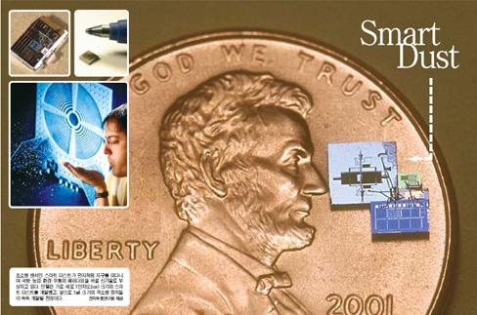
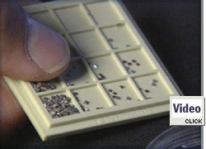
SMART DUST
by
Christy Esther S
10MBE0005

Slide 2
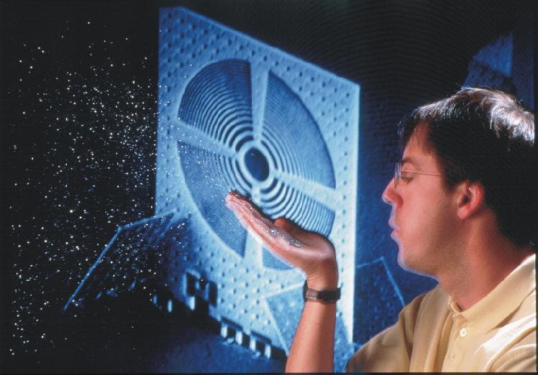
Smart Sensors
Tiny, wireless sensors (or) motes.
Kris Pister and Randy,1998 (UC BERKELEY)
Smart sand

Slide 3
Smart sensors!
Size of a pin head- monitors all types of physical quantities such as:
- Temperature
- Humidity
-Motion
-Light Levels
-Pollution etc

Slide 4
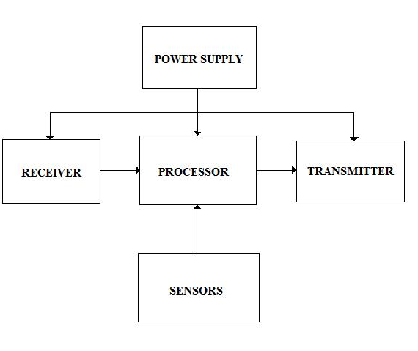
Block Diagram

Slide 5
Role of MEMS- Levels of Integration:
This Integrates
Transducers
Processors
Memory
Solar powered Batteries
Communication Interfaces
on a single micro miniscule chip.
Made possible through MEMS technology

Slide 6
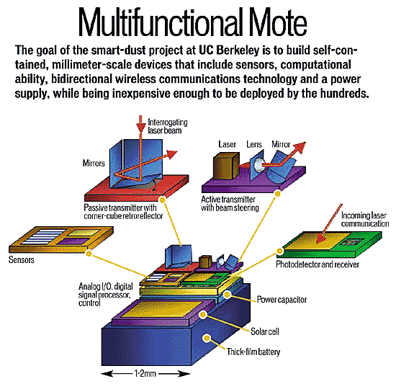

Slide 7
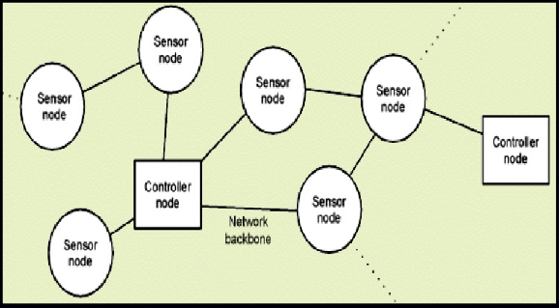
Sensors talk to each other..
Distributed sensor network
Consists of a Network backbone on which many nodes reside
Nodes are classified as
Sensor nodes
Controller nodes
Smart Mesh:-

Slide 8
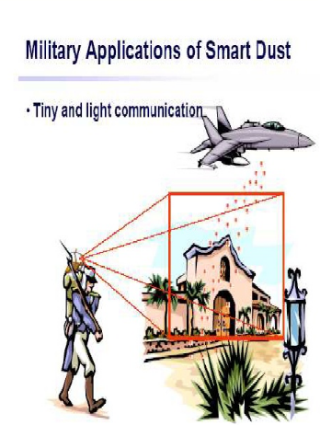
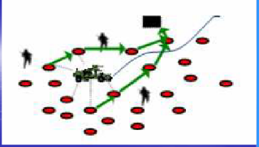
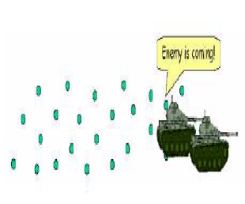
Applications- Military applications:

Slide 9
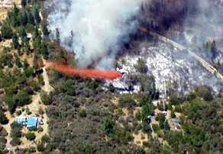
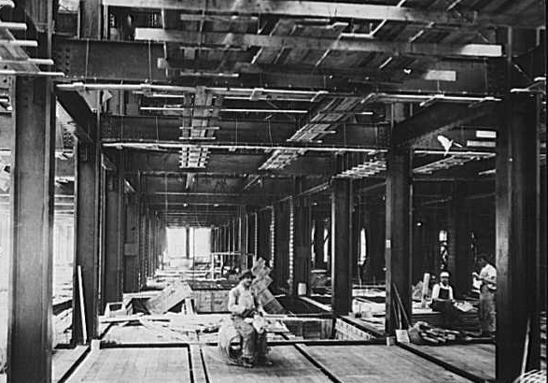
Monitoring buildings &bridges Forest fires

Slide 10
Medical Applications
Like a Personal health monitor (PDA), receives and analyzes data from a number of sensors (eg: ECG, EMG, blood pressure, pulseoxymeter)
Glucose level Monitors
Cancer detectors and general health monitors
Tracking and monitoring of doctors and patients inside the hospitals

Slide 11
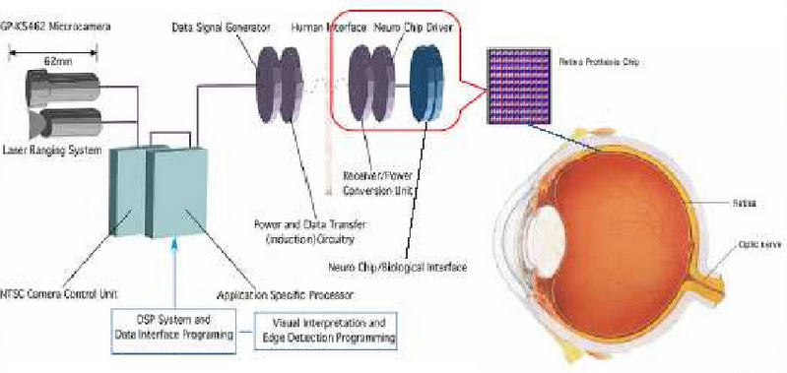
Sensors for visually impaired

Slide 12
Interface for Quadriplegic
Put " motes "on
a quadriplegic's face,
to monitor, blinking
& facial twitches
and send them
as commands to
a wheelchair/computer.

Slide 13
Advantages over traditional sensors
Size very small!
Low cost
Distributed measurements possible
Disadvantages
Privacy going public- privacy laws
Environmental impacts-inhaling sensors

